Slide 1

Global Academy of Technology Department of Computer Science and Engineering
Technical Seminar (15CSS86)
Blockchain and Cryptocurrency
Name : SANJANA B
USN : 1GA15CS130
Guide
Mrs. Jyothi R
Assistant Professor
Dept. of CSE, GAT

Slide 2
Index
Objective
Abstract
Introduction
Problem Statement
Implementation
Applications
Conclusion
Bibliography

Slide 3
Objective
Establishment of secured, trusted and decentralized autonomous ecosystem, for better usage of the legacy devices, infrastructure and resources.

Slide 4
Abstract
Emerging decentralized architecture and distributed computing paradigm underlying Bitcoin, cryptocurrencies, blockchain has attracted intensive attention in both research and applications.
Related fundamental rationales, technical advantages, existing and potential ecosystems of bitcoin and other cryptocurrencies with potential applications are discussed.

Slide 5
Introduction
Blockchain is the fundamental technology underlying the emerging cryptocurrencies including bitcoin.
Blockchain can be defined as a kind of decentralized shared ledger that uses chronological, encrypted and chained blocks to store verifiable and synchronized data.
It has many desirable features in both its technical and organizational aspects.

Slide 6
Bitcoin is one of the most successful application scenarios of blockchain.
Bitcoin and most other cryptocurrencies differ from the traditional electronic cash in five aspects.
Completely decentralized without central control.
Pseudo-anonymous like e-mail.
Limited currency issuance.
Open-source to public.
It is a sequence of zeros and ones, it will gain value by increasing users.

Slide 7
Problem Statement

Slide 8
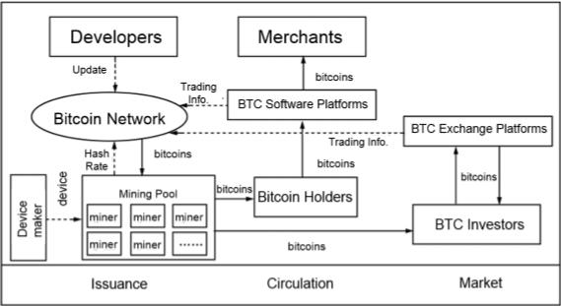
Implementation
Bitcoin ecosystem.

Slide 9
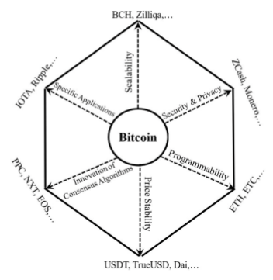
Six dimensions in cryptocurrency innovation.

Slide 10
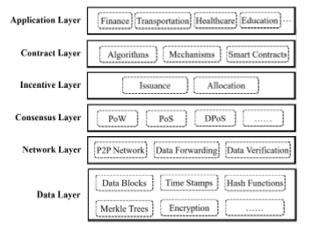
Reference model of blockchain.

Slide 11
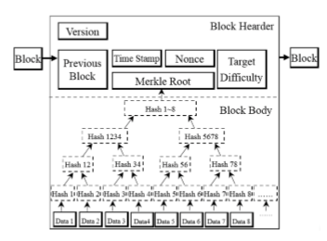
Data Layer of blockchain.

Slide 12
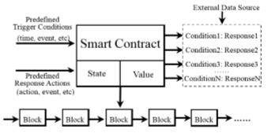
Blockchain-enabled smart contracts.

Slide 13
Applications
Blockchain-Powered Smart Devices.
Decentralized Sharing Economy.
Blockchain-Powered Freight Transportation.
Blockchain-Based Enterprise Management and Knowledge Automation.

Slide 14
Conclusion
Wide spectrum applications of blockchain and cryptocurrencies in various types of industries, ranging from the underlying techniques of data storage to a variety of high level business models.
Six-layer reference model for the blockchain framework.
To stimulate more detailed investigation and innovative research in new direction.

Slide 15
Bibliography
[1] Blockchain and Cryptocurrencies: Model, Techniques, and Applications- Young Yuan, Senior Member, IEEE, and Fei-Yue Wang, Fellow, IEEE.
[2] Towards blockchain-based intelligent transportation systems- Y. Yuan and F.-Y. Wang, in Proc. IEEE 19th Int. Conf. Intell. Transp. Syst. (ITSC), Rio de Janeiro, Brazil, 2016
[3] Blockchain intelligence: Cornerstone of the future smart economy and smart societies- F.-Y. Wang, in Proc. 2nd World Intell. Congr., Tianjin, China, 2018.

